Slide 1

Weekly Progress
Team C

Slide 2
Progress Update on Front-End Development
Creates a framework for the basic UI
-Main page

Slide 3
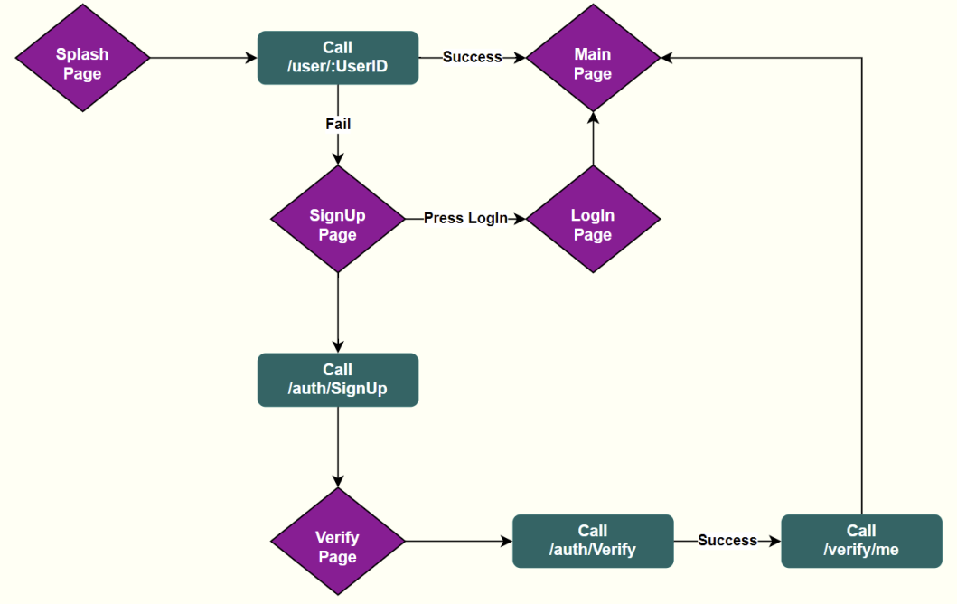
Page Transition Flowchart

Slide 4
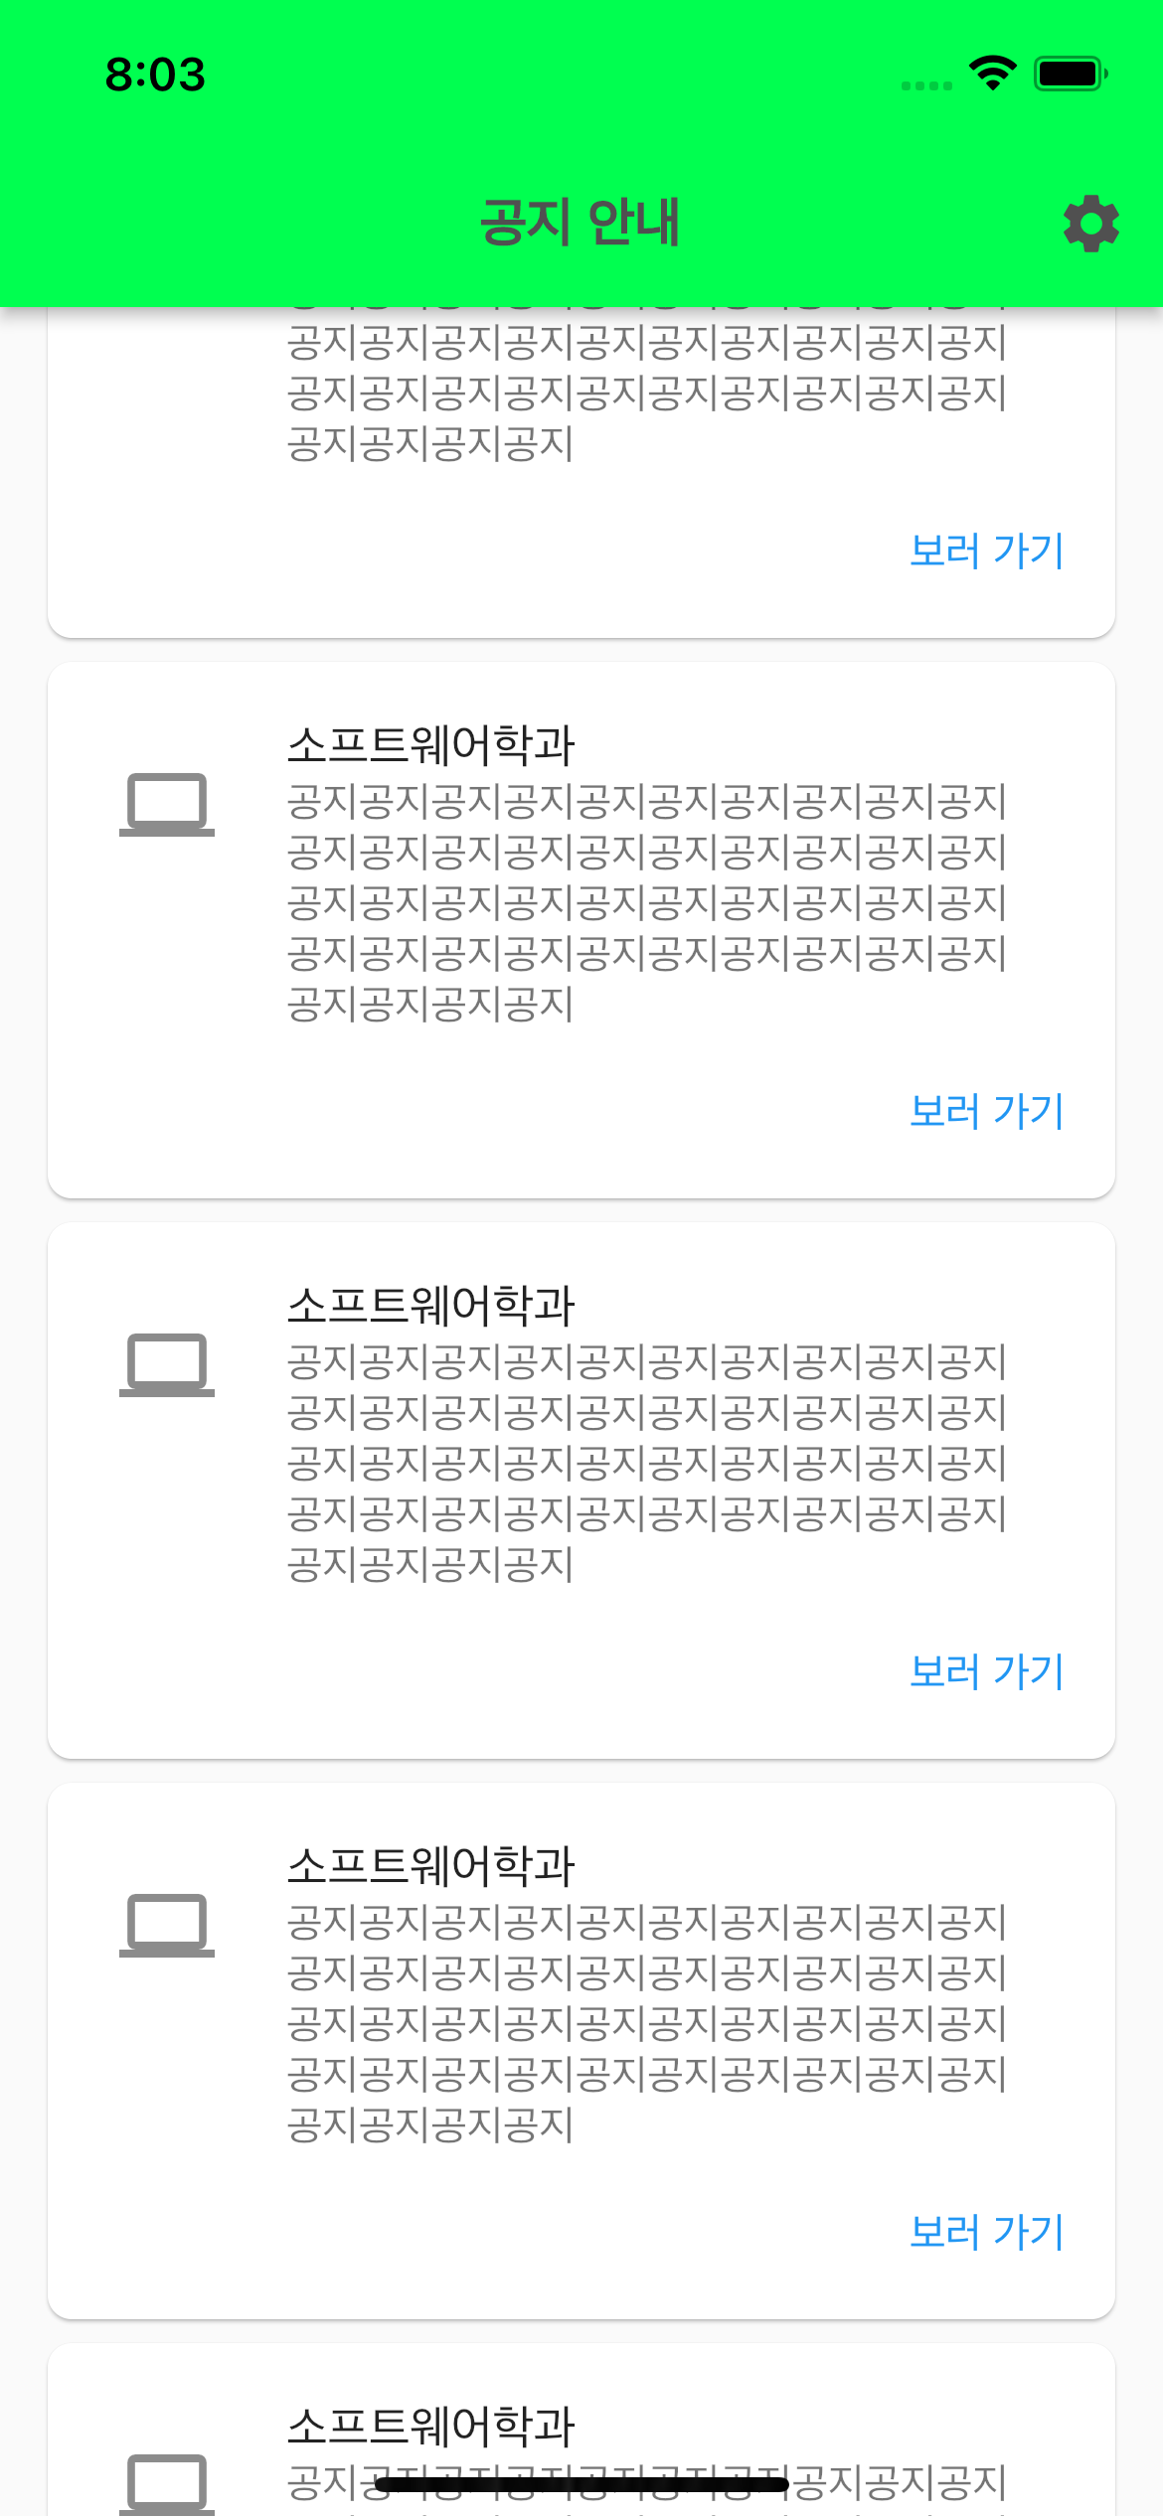
Main page

Slide 5
Setting
Setting
- Server setting
- Crawler Setting
- CronJob Setting
- Database Setting

Slide 6
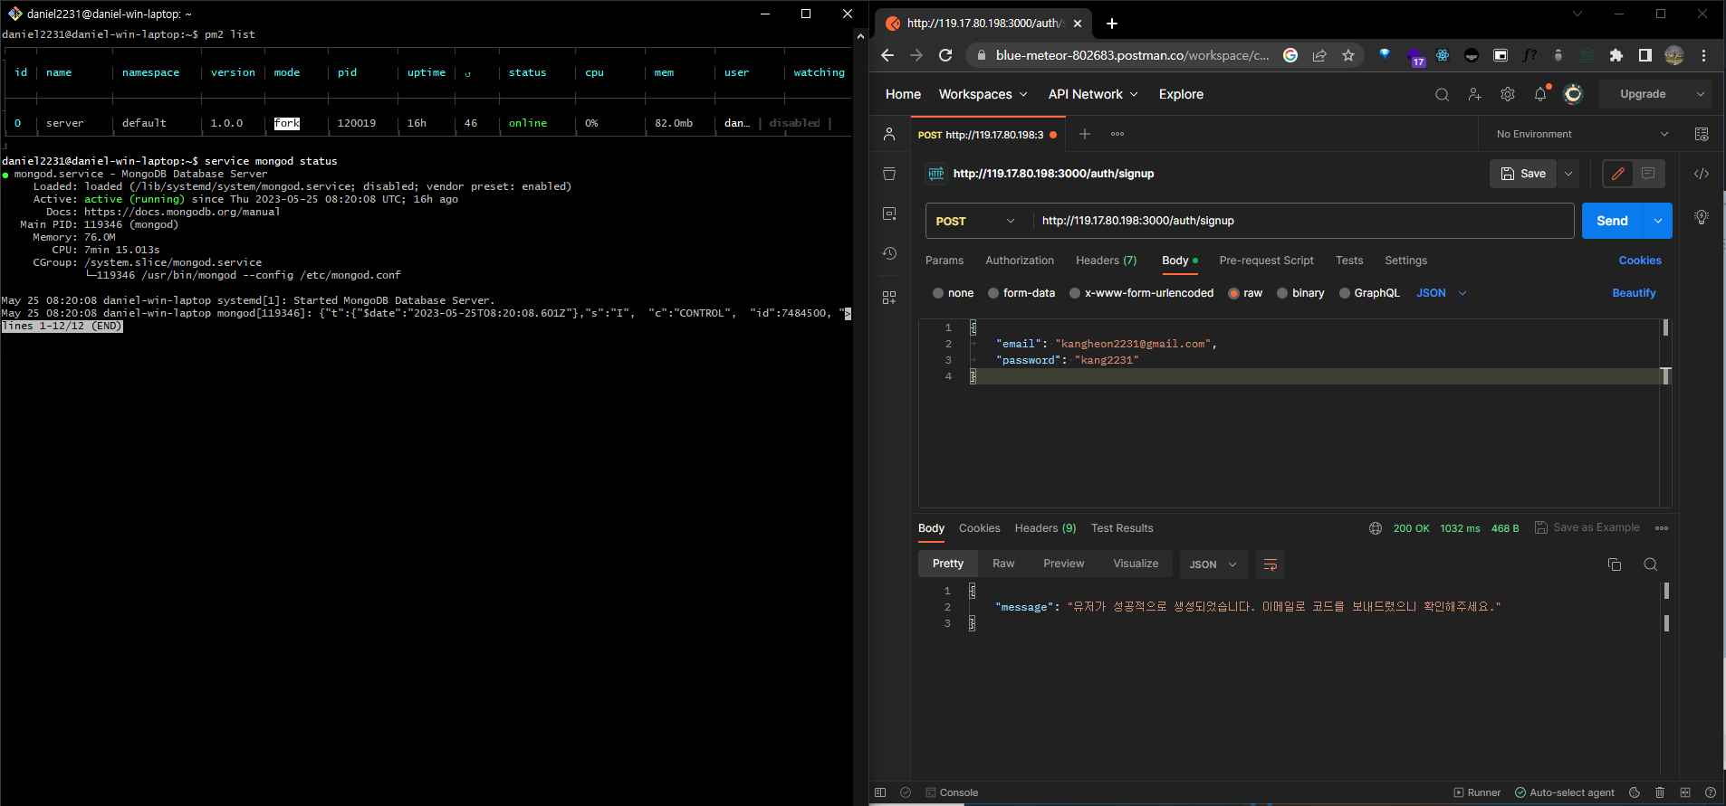
Server/DB setting

Slide 7
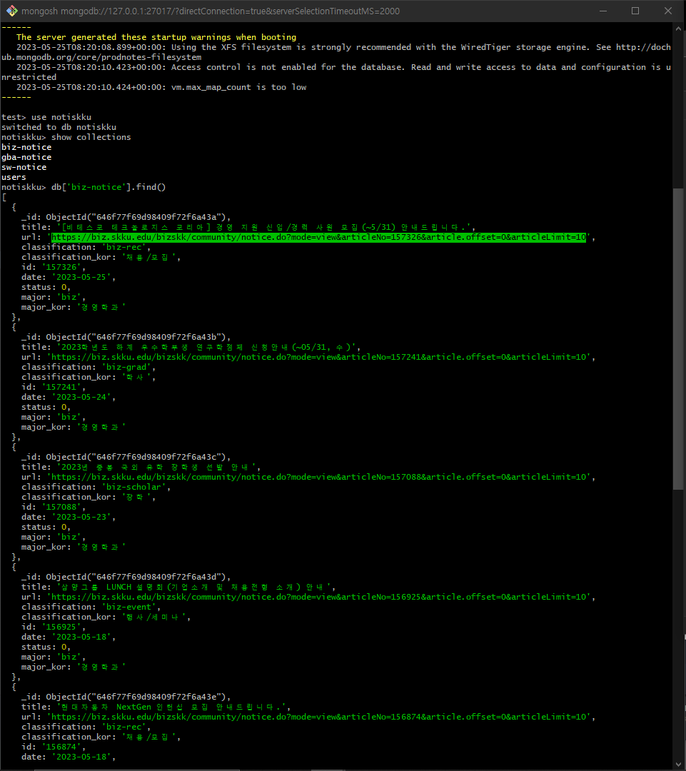
Crawler/Cronjab setting

Slide 8
NEXT WEEK

Slide 9
Next Week
-Link page to the server
-Additional UI modifications
-An overall test

